Slide 1

Electric Motor Temperature Prediction
Group 5
Team members
Shraddha Surve
Shreyas K chudi
Kunal Shelke
Bhuvaneshwaran G

Slide 2
Business Problem:
Objective:
The objective of the analysis is to predict the Permanent Magnet surface temperature representing the rotor temperature of the electric motor when running, based on the provided set of other attributes
Attributes:
ambient
Ambient temperature as measured by a thermal sensor located closely to the stator.
coolant
Coolant temperature. The motor is water cooled. Measurement is taken at the outflow.
u_d
Voltage d-component
u_q
Voltage q-component
motor_speed
Motor speed
torque
Torque induced by current.
i_d
Current d-component

Slide 3
i_q
Current q-component
pm
Permanent Magnet surface temperature representing the rotor temperature. This was measured with an infrared thermography unit.
stator_yoke
Stator yoke temperature is measured with a thermal sensor.
stator_tooth
Stator tooth temperature is measured with a thermal sensor.
stator_winding
Stator winding temperature measured with a thermal sensor.
profile_id
Each measurement session has a unique ID. Make sure not to try to estimate from one session onto the other as they are strongly independent.

Slide 4
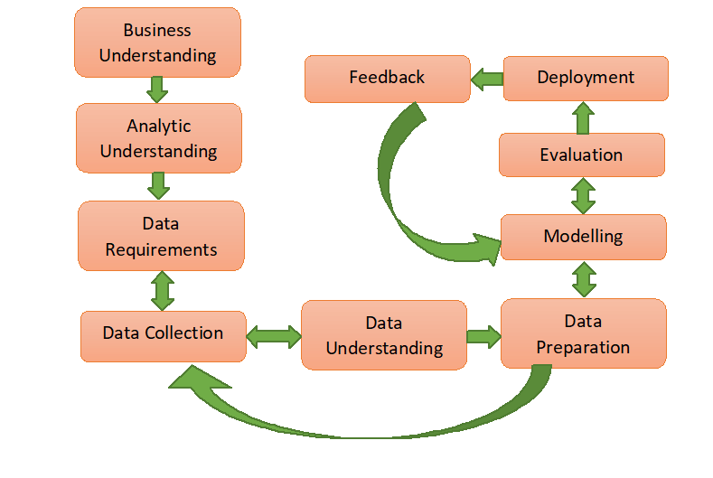
Project Architecture / Project Flow

Slide 5
Exploratory Data Analysis (EDA) and
Feature Engineering

Slide 6
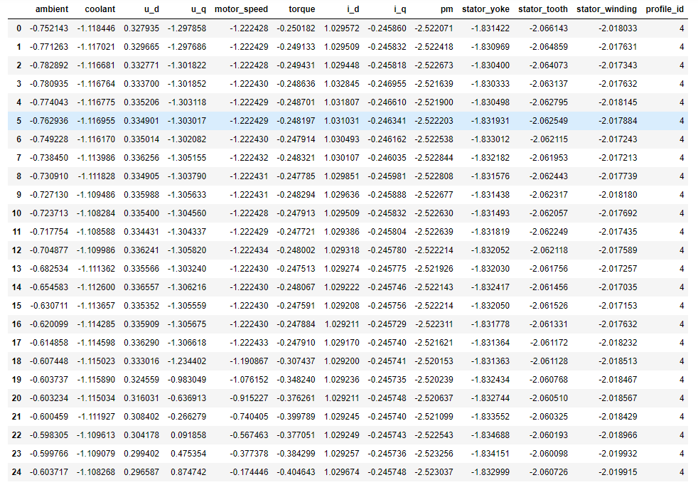
Data set details
Number of observations/rows : 998070
Number of variables/columns : 13
Number of missing cells : 0
number of duplicate observations : 0

Slide 7
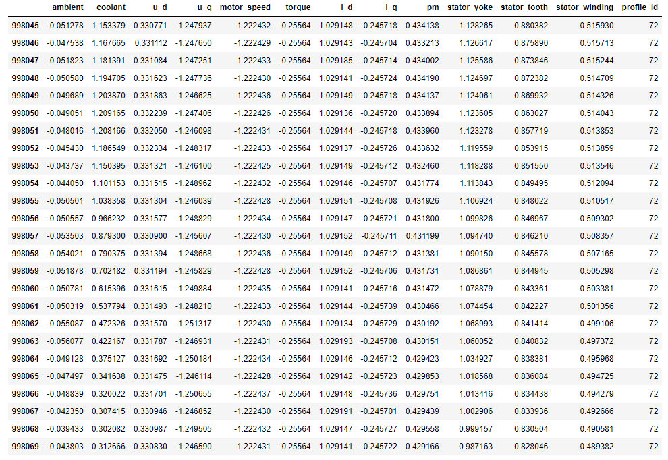

Slide 8
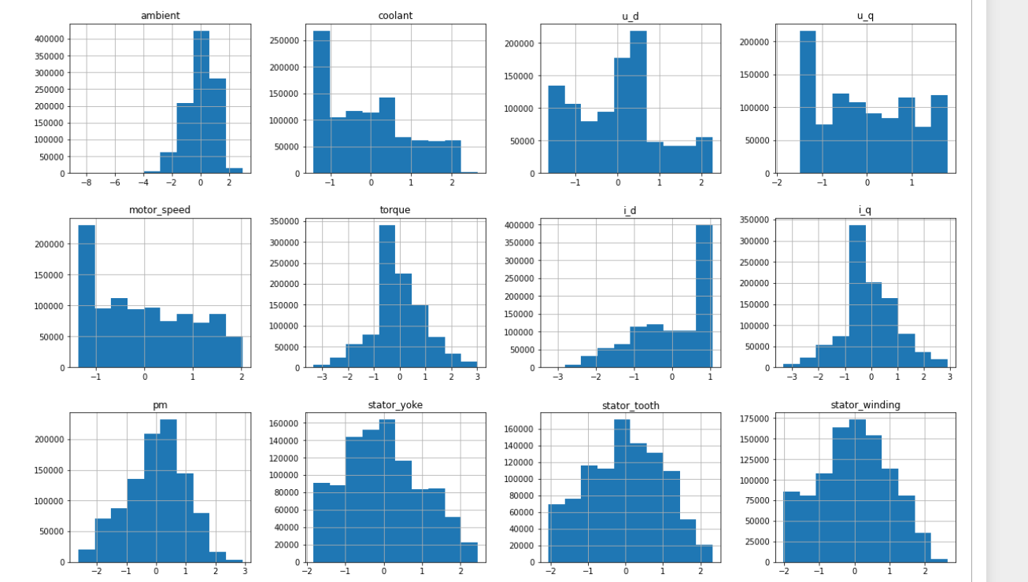
Histogram for Each attribute:

Slide 9
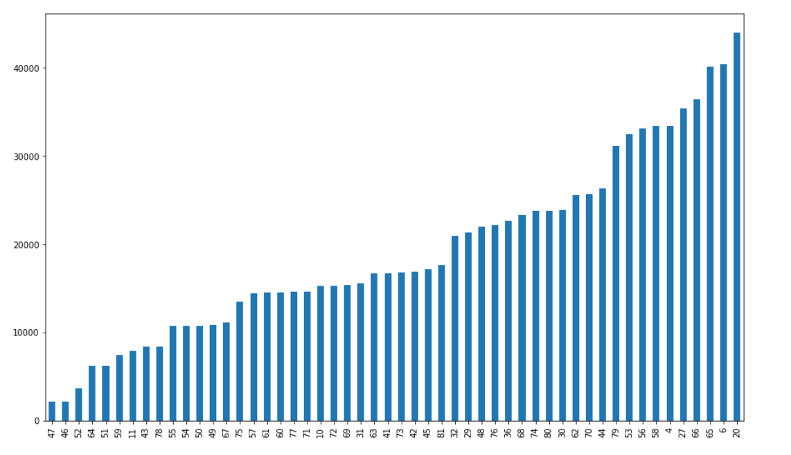
Count plot for profile id: Observation- * Profile id –20 has highest number of observation

Slide 10
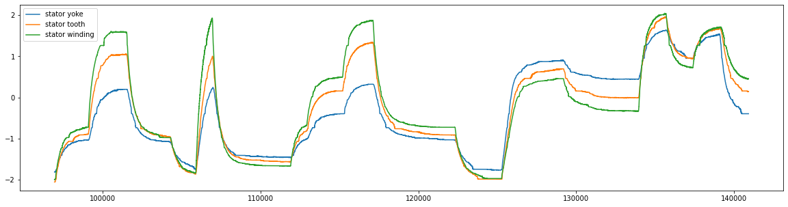
Line plot of stator yoke ,stator tooth and stator winding for profile id 20:
Observation:
All three stator components follow a similar measurement variance.
We have observed that initially the stator yoke temperature is low as compared to temperature of stator winding but as we progress in time, the stator yoke temperature goes above the temperature of stator winding.

Slide 11
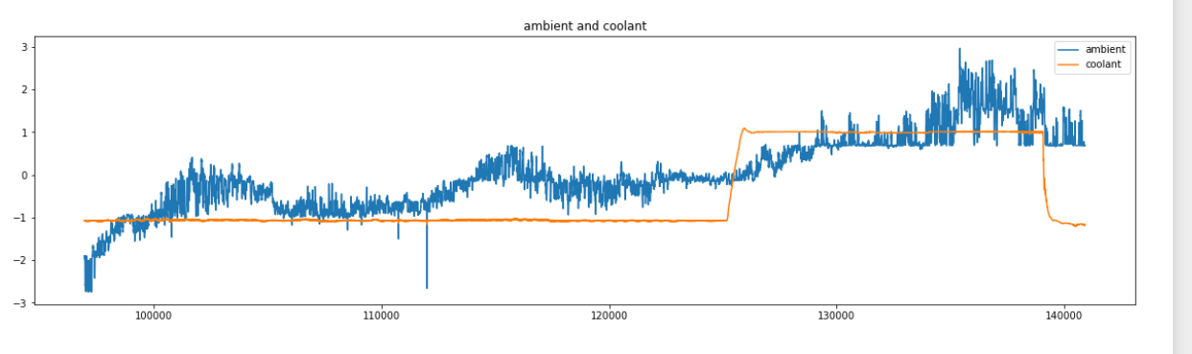
Line plot of ambient and coolant for profile id 20:
Observation:
ambient temperature is increasing gradually but coolant temperature is static for some period
at some point coolant temperature is increased and decreased again

Slide 12
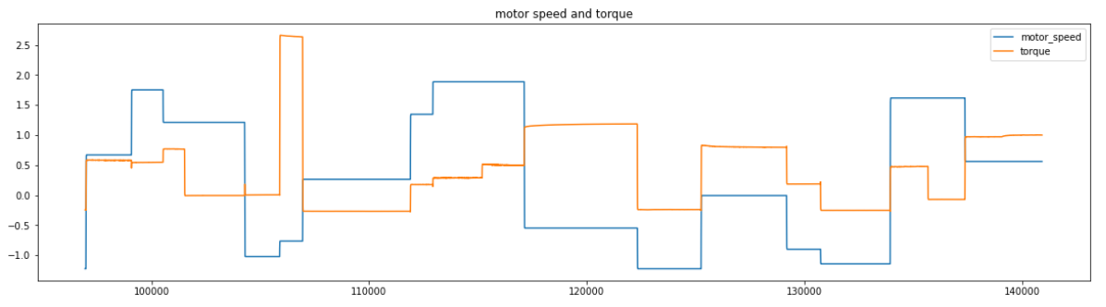
Line plot of Motor Speed and torque for profile id 20:
Observation:
We can see fluctuations in line chart for torque and speed

Slide 13
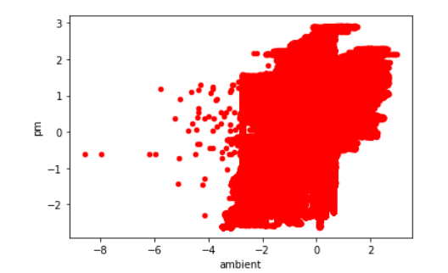
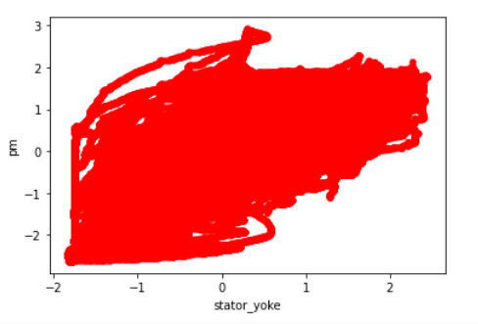
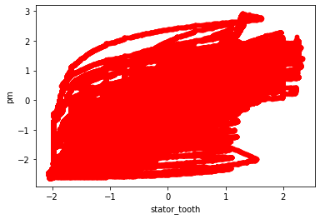
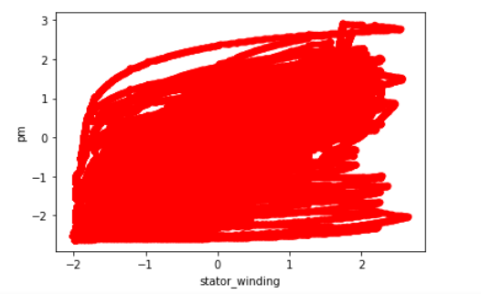
scatter plot for independent variable with dependent variables
Ambient ,Stator_yoke,stator_tooth and stator_winding are corelated with PM

Slide 14
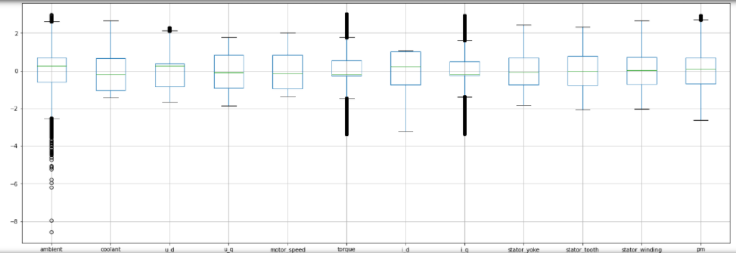
Outliers Detection
We have few variable, having outliers in them.
ambient, voltage d-component(u_d), torque, current d-component(i_d), permanent magnet surface temperature(pm)
Deleted the outliers with above upper limit and below lower limit

Slide 15
Feature Engineering

Slide 16
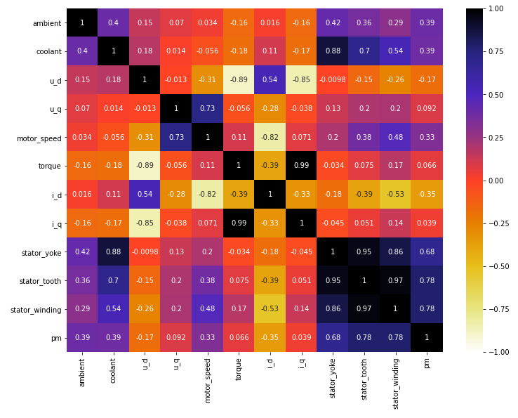
From the data and heatmap, we can note that the following columns are highly corelated with each other
coolant and stator_yoke,
current q-component and torque,
stator_tooth and stator_yoke
stator_winding with stator_yoke.

Slide 17
Variable such as torque and voltage d-component, current d-component and motor speed, current q-component and voltage d-component are negatively corelated.
Since stator_yoke, stator_winding, stator_tooth, torque, current d-component and current q-component are depicting of being multicollinearity.
After removing few variable to reduce multicollinearity and eliminating the outliers, the data is now of:
number of variables : 9
number of observations : 814996

Slide 18
Model Building

Slide 19
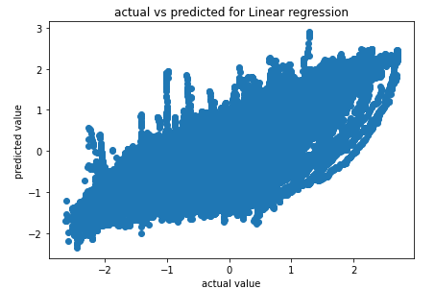
Model – Linear Regression
Multiple linear regression (MLR), also known simply as multiple regression, is a statistical technique that uses several explanatory variables to predict the outcome of a response variable. Multiple regression is an extension of linear (OLS) regression that uses just one explanatory variable.
Linear Regression Results:
Train Accuracy:69.32 %
Test Accuracy:69.45 %
RMSE Score:0.528
MAE Score:0.409
R^2 Score:69.455
CV R^2 Score:69.35

Slide 20
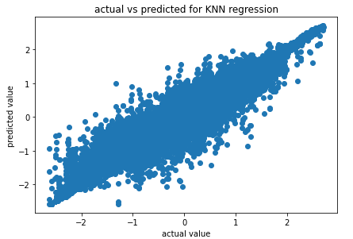
Model – KNN Regressor
KNN regression is a non-parametric method that, in an intuitive manner, approximates the association between independent variables and the continuous outcome by averaging the observations in the same neighbouringhood.
KNN Regression Results:
Train Accuracy:98.70 %
Test Accuracy:98.29 %
RMSE Score:0.124
MAE Score:0.047
R^2 Score:98.294
CV R^2 Score:99.455

Slide 21
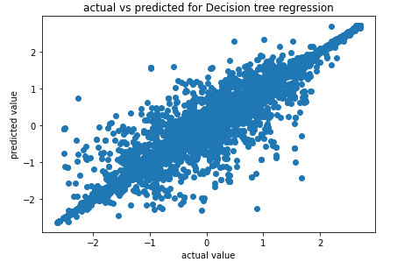
Model – Decision Tree Regressor
Decision tree builds regression or classification models in the form of a tree structure. It breaks down a dataset into smaller and smaller subsets while at the same time an associated decision tree is incrementally developed. The final result is a tree with decision nodes and leaf nodes.
Decision tree regression Results:
Train Accuracy:100 %
Test Accuracy:99.329 %
RMSE Score:0.078
MAE Score:0.013
R^2 Score:99.329
CV R^2 Score:100

Slide 22
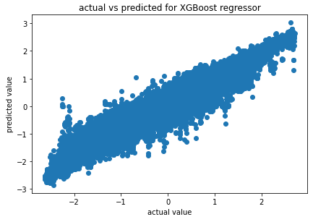
Model –XGBoost Regressor
XGBoost is an efficient implementation of gradient boosting that can be used for regression predictive modeling. XGBoost minimizes a regularized (L1 and L2) objective function that combines a convex loss function (based on the difference between the predicted and target outputs) and a penalty term for model complexity.
XGBoost regression Results:
Train Accuracy:95.946 %
Test Accuracy:95.789 %
RMSE Score:0.196
MAE Score:0.133
R^2 Score:95.798
CV R^2 Score:96.010

Slide 23
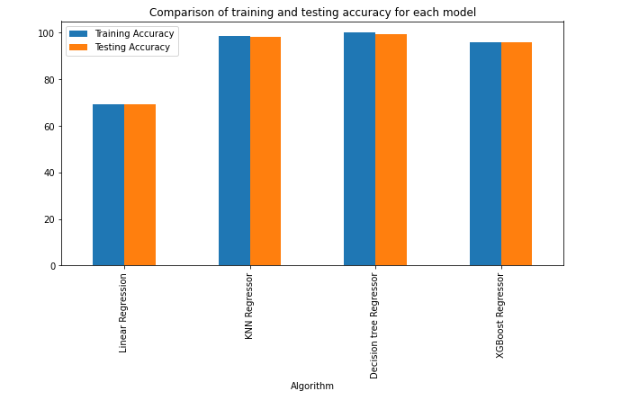
Comparison of results of different models built
Decision tree is giving highest accuracy in training and testing

Slide 24
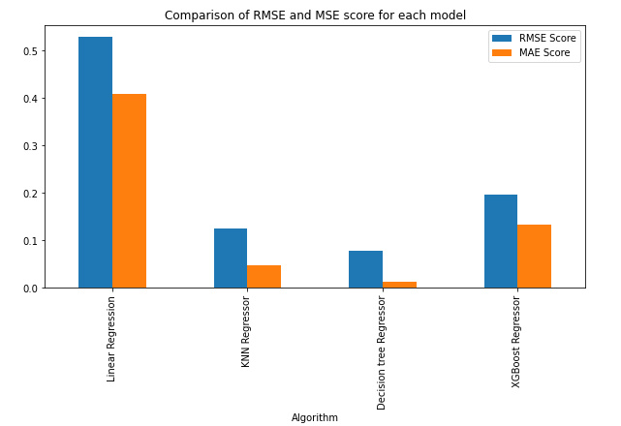
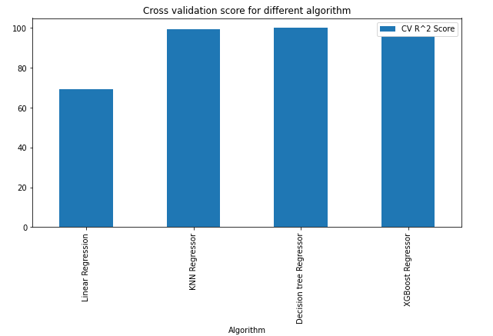
The RMSE Score and MAE Score should be as low as possible, and Decision Tree has the lowest.
The cross validation R^2 Score should be as high as possible. Both KNN and decision tree have high value but decision tree has the highest cross validation R^2 Score than that of KNN.

Slide 25
Model Deployment using R shiny / Flask or any other method

Slide 26
Steps for Deployment
STEPS:
Created a pickle file for model
Connected this pickle file to flask web framework(app.py)
Created HTML file
Created requirement.txt file
Succesfully deployed the model on flask server

Slide 27
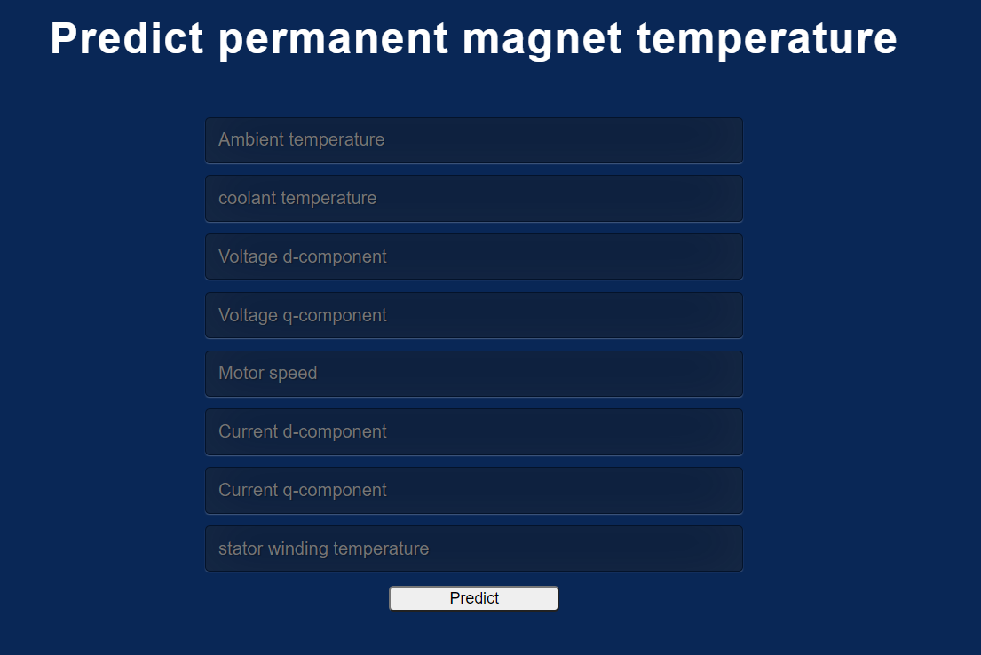
OuoOutput of final deployment

Slide 28
Challenges faced?
We have faced issues while working on deployment part using flask server . There were some errors that we have faced
How did you overcome?
To overcome this issue we have taken a help of resources like Google and You tube and got successful in that

Slide 29
Thank you

